Slide 1

COMP821 Information SecuritY
Session I Introduction to information security
Krassie Petrova, February 2024

Slide 2
Orientation
Information security: developeing and maintaining controls and mechanisms for protecting information assets (systems) against attacks; dealing with the consequences of successful attacks
Session 1
Threat environment. Attackers and attacks.
Planning for information security - Risk analysis and Security policies

Slide 3
THE Threat environment—attackers and attack
There are several resources - industry reports – in the resources section

Slide 4
Security Goals and the threat environment
SECURITY OBJECTIVES/GOALS
Confidentiality:
Integrity:
Availability:
The Threat Environment
The threat environment consists of the types of attackers and attacks that companies face
[Here and in some other slides, see also the Notes to slide]
Notes:
Confidentiality: means that people cannot read sensitive information, either while it is on a computer or while it is traveling across a network.
Integrity: means that attackers cannot change or destroy information, either while it is on a computer or while it is traveling across a network. Or, at least, if information is changed or destroyed, then the receiver can detect the change or restore destroyed data.
Availability: means that people who are authorized to use information are not prevented from doing so

Slide 5
Compromises and countermeasures
Compromises / breaches
Countermeasures/controls . Mostly:
Preventative
Detective
Corrective
Notes:
Compromises /attacks
Successful attacks, also called incidents, or breaches
Countermeasures/controls
Tools used to thwart attacks. Also called safeguards, protections, and controls

Slide 6
SOME THREAT sources
Employees and Ex-Employees
Competitors ………………………………………….and just us being Humans
Criminal use of computers for financial gain
Data breaches, identity theft , malware, hackers
Attacks by organized terrorists (cyber terror):
May attack IT resources directly; Use the Internet for recruitment and coordination
Use the Internet to augment physical attacks
Disrupt communication among first responders
Use cyberattacks to increase terror in physical attacks
Notes:
Employees and Ex-Employees Are Dangerous because
They have knowledge of internal systems
They often have the permissions to access systems
They often know how to avoid detection
Employees generally are trusted – but IT and especially IT security professionals are the greatest employee threats (Qui custodiet custodes?)
Employee Financial Theft: Misappropriation of assets’ Theft of money
Employee Theft of Intellectual Property (IP): Copyrights and patents (formally protected); Trade secrets: plans, product formulations, business processes, and other info that a company wishes to keep secret from competitors
Commercial espionage by corporate competitors
Attacks on confidentiality
Public information gathering
Company website and public documents
Facebook pages of employees, etc.
Trade secret espionage
May only be litigated if a company has provided reasonable protection for those secrets
Reasonableness reflects the sensitivity of the secret and industry security practices

Slide 7
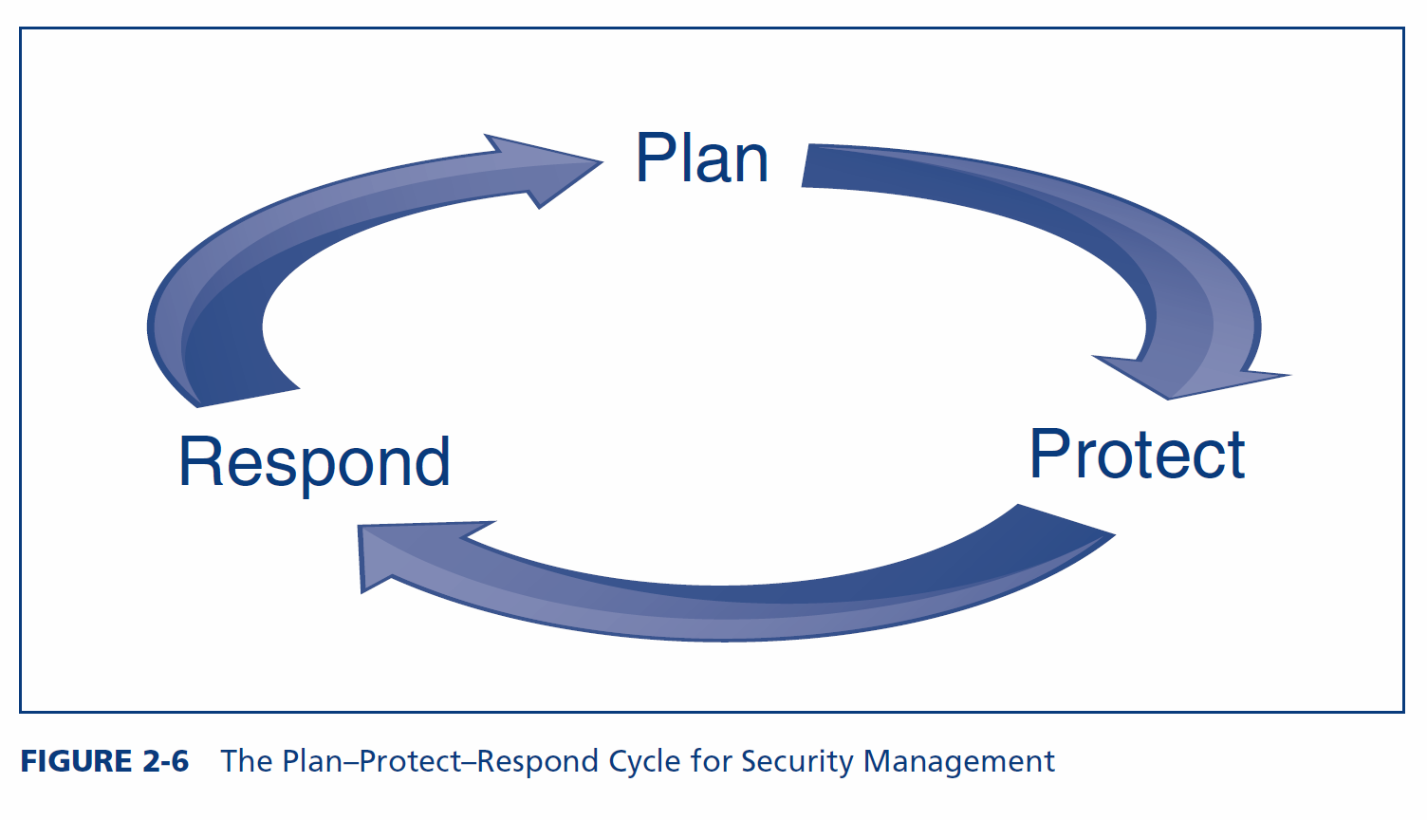
Management: Abstract but more important
A process
Figures cited as per ed 4.

Slide 8
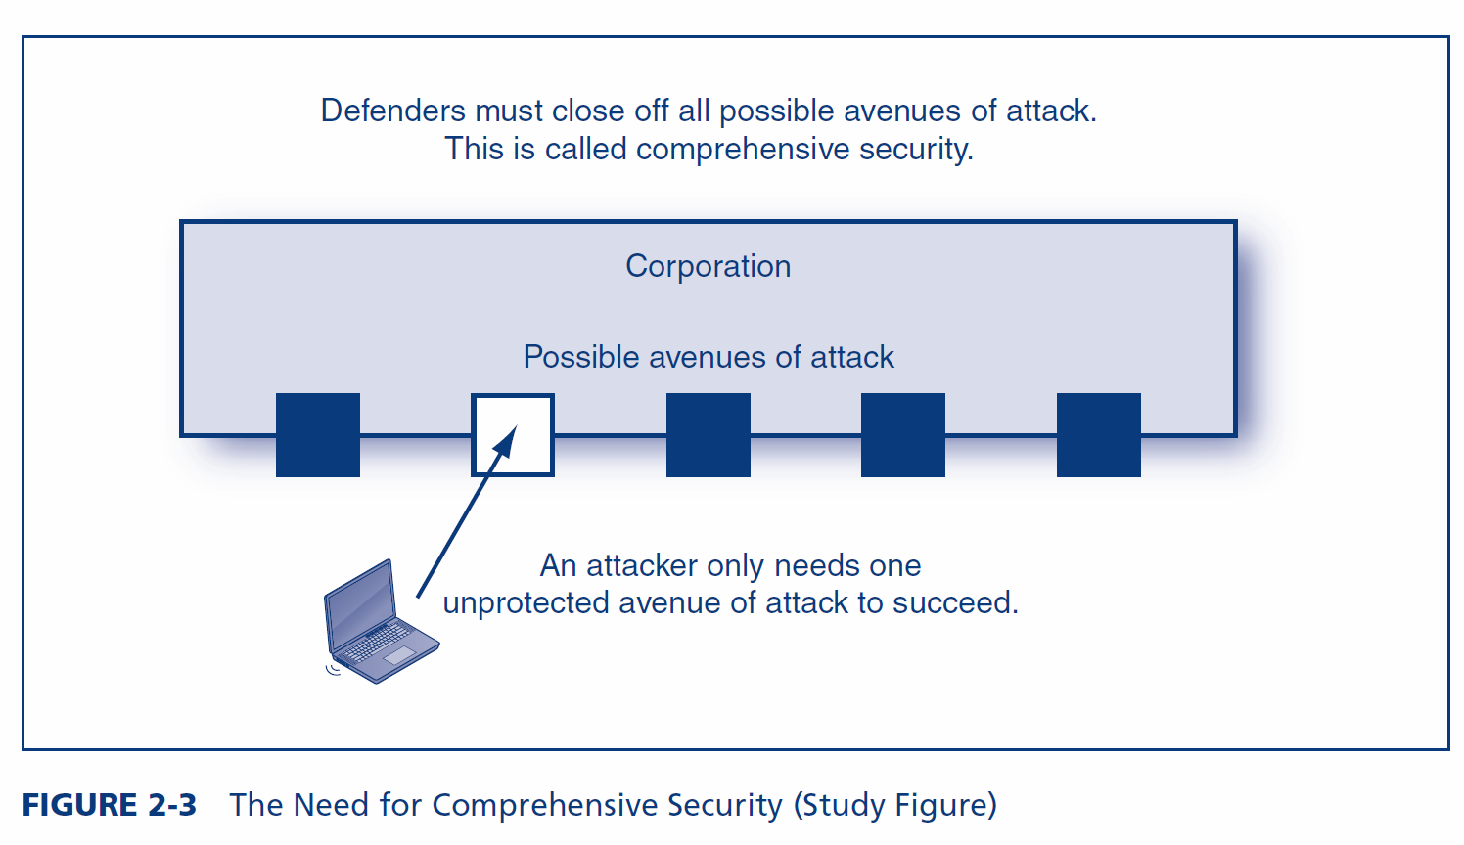
Comprehensive Security

Slide 9
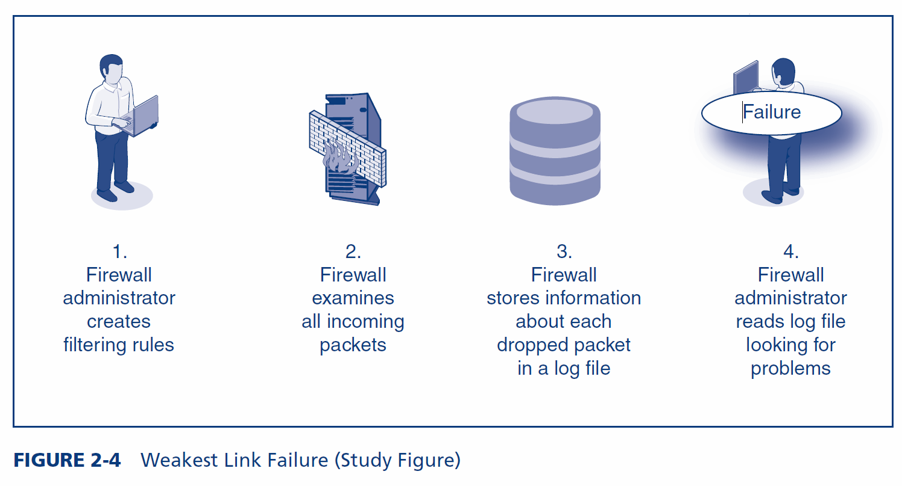
The Weakest Link
A failure in any component will lead to failure for the entire system

Slide 10
Strategic IT Security Planning
What to do
Identify Corporate Resources Needing Protection
Identify Current IT Security Gaps
Identify Driving Forces
And
Develop a remediation plan for all security gaps
Develop a remediation plan for every resource unless it is well protected
Prioritize projects that will provide the largest returns
WHO is doing it: CHIEF INFORMATION SECUIRTY OFFICER (CISO) (inhouse) ( outsourcing)
Notes:
Identify Corporate Resources Needing Protection
Enumerate all resources
Rate each by sensitivity
Identify Current IT Security Gaps
Identify Driving Forces
The threat environment
Compliance laws and regulations
Corporate structure changes, such as mergers

Slide 11
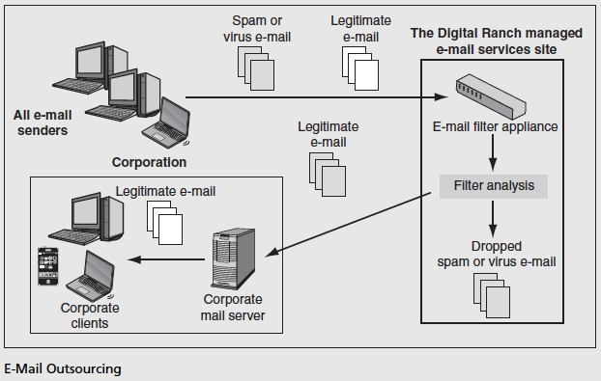
Example 1 - E-Mail Outsourcing

Slide 12
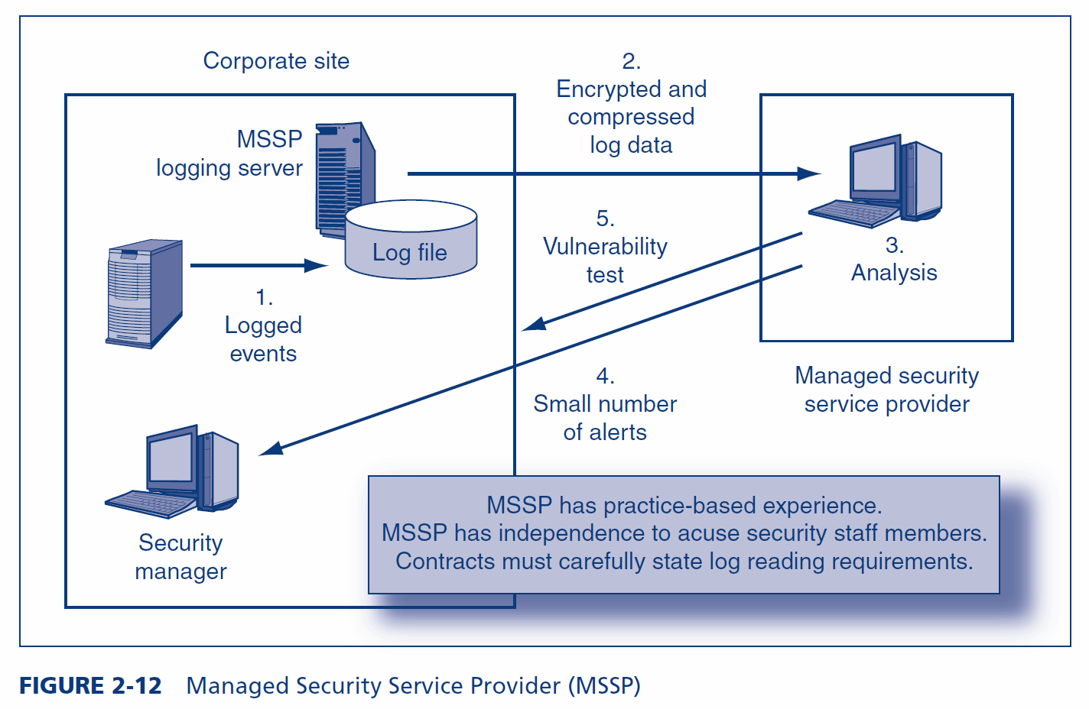
Example2 = Managed Security Service Provider (MSSP)

Slide 13
Lessons learnt from the case studies in the NCSC Cyberthreat Report 2021/2022
What is MITRE ATT&CK? https://attack.mitre.org/
NCSC= National Cyber Security Centre, under the Government Communications Security Bureau
https://www.ncsc.govt.nz/news/cyber-threat-report-for-20212022-released/
https://www.ncsc.govt.nz/news/cyber-threat-report-for-20212022-released/#:~:text=The%20NCSC%20recorded%20350%20incidents,404%20in%20the%20previous%20year.

Slide 16
Page 7

Slide 17
Page 8

Slide 18
Page 10

Slide 19
Planning for information security - Risk analysis and Security policies

Slide 20
Risk Analysis
Annualized Rate of Occurrence (ARO)
Annual probability of a compromise
Annualized Loss Expectancy (ALE)
Expected loss per year from this type of compromise.
ALE=SLE*ARO
ALE: Annualized Loss Expectancy
Asset Value (AV)
X Exposure Factor (EF)
Percentage loss in asset value if a compromise occurs
Single Loss Expectancy (SLE)
Expected loss in case of a compromise.
SLE=AV*EF
SLE: Single Loss Expectancy
Notes:
Realities
Can never eliminate risk
“Information assurance” is impossible
Risk Analysis
Goal is reasonable risk
Risk analysis weighs the probable cost of compromises against the costs of countermeasures
Also, security has negative side effects that must be weighed
Problems with classic risk analysis : does nit consider Total Cost of Incident (TCI)
Exposure factor in classic risk analysis assumes that a percentage of the asset is lost
In many cases, damage does not come from asset loss
For instance, if personally identifiable information is stolen, the cost is enormous but the asset remains
Must compute the total cost of incident (TCI)
Include the cost of repairs, lawsuits, and many other factors

Slide 21
Classic Risk Analysis Calculation
Countermeasure A should reduce the exposure factor by 75% (from 80% to 20%). Its cost is $17000 per year. The related attack is estimated to be successful once every two years
 | Base Case | Countermeasure (control) in place
 |  | Control A
Asset Value (AV) | $100,000 | $100,000
Exposure Factor (EF) | 80% | 20%
Single Loss Expectancy (SLE): = AV*EF | $80,000 | $20,000
Annualized Rate of Occurrence (ARO) | 50% | 50%
Annualized Loss Expectancy (ALE): = SLE*ARO | $40,000 | $10,000
ALE Reduction for Countermeasure |  | $30,000 | Saving before cost of A
Annualized Countermeasure Cost |  | $17,000 | Cost of A
Annualized Net Countermeasure Value |  | $13,000

Slide 22
CONT
 | Base Case | Countermeasure
 |  | B
Asset Value (AV) | $100,000 | $100,000
Exposure Factor (EF) | 80% | 80%
Single Loss Expectancy (SLE): = AV*EF | $80,000 | $80,000
Annualized Rate of Occurrence (ARO) | 50% | 25%
Annualized Loss Expectancy (ALE): = SLE*ARO | $40,000 | $20,000
ALE Reduction for Countermeasure | NA | $20,000
Annualized Countermeasure Cost | NA | $4,000
Annualized Net Countermeasure Value | NA | $16,000
Countermeasure B should cut the frequency of compromises in half. Its annual cost is $4000

Slide 23
CoMPARE:
 | Base Case | Countermeasure
 |  | A | B
Asset Value (AV) | $100,000 | $100,000 | $100,000
Exposure Factor (EF) | 80% | 20% | 80%
Single Loss Expectancy (SLE): = AV*EF | $80,000 | $20,000 | $80,000
Annualized Rate of Occurrence (ARO) | 50% | 50% | 25%
Annualized Loss Expectancy (ALE): = SLE*ARO | $40,000 | $10,000 | $20,000
ALE Reduction for Countermeasure | NA | $30,000 | $20,000
Annualized Countermeasure Cost | NA | $17,000 | $4,000
Annualized Net Countermeasure Value | NA | $13,000 | $16,000
Although Countermeasure A reduces the ALE more,
Countermeasure B is much less expensive.
The annualized net countermeasure value for B is larger.
The company should select Countermeasure B.
Notes:
More problems with classic risk analysis
Many-to-Many Relationships between Countermeasures and Resources
Classic risk analysis assumes that one countermeasure protects one resource
Single countermeasures, such as a firewall, often protect many resources
Single resources, such as data on a server, are often protected by multiple countermeasures
Extending classic risk analysis is difficult
Impossibility of Knowing the Annualized Rate of Occurrence
There simply is no way to estimate this
This is the worst problem with classic risk analysis
As a consequence, firms too often merely rate their resources by risk level (exposure)

Slide 25
Responding to Risk
Four Main Choices When You Face Risk
Risk reduction
Risk acceptance
Risk transference
Risk avoidance
Risk Reduction : Most common. Install countermeasures to reduce harm. Makes sense only if risk analysis justifies the countermeasure
Risk Acceptance: If protecting too expensive, accept losses when they occur. Good for small unlikely losses ; Good for large but rare losses
Risk Transference: Buy insurance against security-related losses. Especially good for rare but extremely damaging attacks. Does not mean a company can avoid working on IT security (If bad security, will not be insurable. With better security, will pay lower premiums)
Risk Avoidance: Do not take a risky action. But…you Lose the benefits of the action. This may cause anger against IT security
Notes:
Risk Reduction : Most common. Install countermeasures to reduce harm. Makes sense only if risk analysis justifies the countermeasure
Risk Acceptance: If protecting too expensive, accept losses when they occur. Good for small unlikely losses ; Good for large but rare losses
Risk Transference: Buy insurance against security-related losses. Especially good for rare but extremely damaging attacks. Does not mean a company can avoid working on IT security (If bad security, will not be insurable. With better security, will pay lower premiums)
Risk Avoidance: Do not take a risky action. But…you Lose the benefits of the action. This may cause anger against IT security

Slide 26
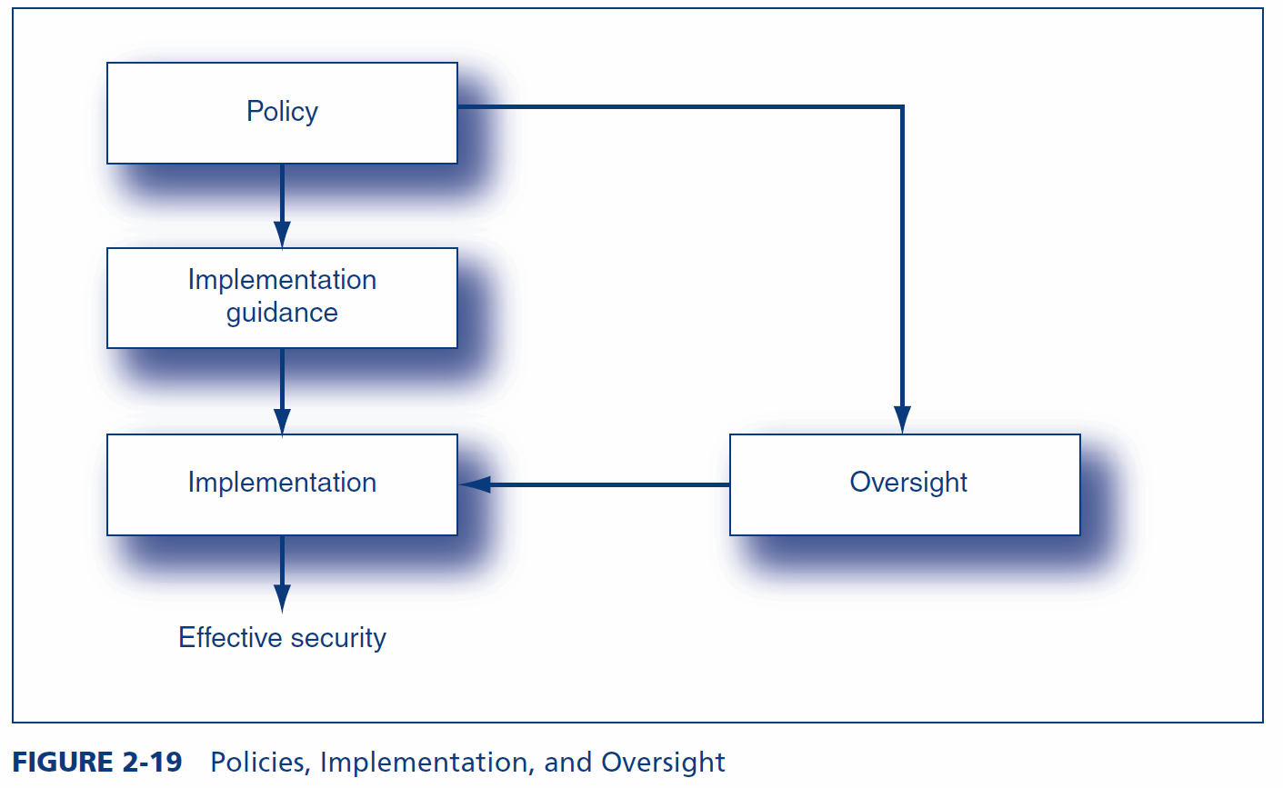
Information security policies

Slide 27
Information security policies: Types and examples
Tiers of Security Policies
One Brief corporate security policy to drive everything plus
Major policies
E-mail
Hiring and firing
Personally identifiable information
IP
…
https://www.aut.ac.nz/privacy
https://www.auckland.ac.nz/en/about-us/about-the-university/policy-hub/research-innovation/conduct/intellectual-property-created-staff-students-policy.html

Slide 28
Other examples
Acceptable use policy
Summarizes key points of special importance for users
Typically, must be signed by users
https://www.auckland.ac.nz/en/about-us/about-the-university/policy-hub/enabling-environment/digital/use/it-acceptable-use-policy.html
Policies for specific countermeasures, e.g., password
https://www.canterbury.ac.nz/about/governance/ucpolicy/staff/password-policy/Password-Policy.pdf

Slide 29
Implementation Guidance
Implementation Guidance : limits the discretion of implementers in order to simplify implementation decisions and avoid bad choices in interpreting policies
No Guidance: Implementer is only guided by the policy itself
Standards versus Guidelines
Standards are mandatory directives
Guidelines are not mandatory but must be considered
Types of Implementation Guidance
Procedures: detailed specifications for how something should be done
Can be either standards or guidelines
Processes: less detailed specifications of what actions should be taken
Necessary in managerial and professional business function
Baselines: checklists of what should be done but not how
Best practices: most appropriate actions in other companies
Recommended practices: normative guidance
Notes:
Procedures
Request/authorization control
Limit the number of people who may make requests on sensitive matters
Allow even fewer to be able to authorize requests
Authorizer must never be the requester
Mandatory vacations to uncover “schemes” that require constant maintenance (presence)
Job rotation to uncover “schemes” that require constant maintenance (presence)

Slide 30
CODE of Ethics –also used for guidance
Characteristics of a code of ethics
Important for having a good workplace and to avoid damaging a firm’s reputation
Applies to everybody (but Senior managers usually have additional requirements)
Improper ethics can result in sanctions, up to and including termination
An employee must report observed unethical behavior
An employee must resolve conflicts of interest
Never exploit one’s position for personal gain
No preferential treatment of relatives
No investing in competitors
No competing with the company while still employed by it
An employee may never divulge
Confidential information
Private information
Trade secrets
https://itp.nz/Members/Code-of-Ethics
Notes:
Ethics
A person’s system of values
Needed in complex situations
Different people may make different decisions in the same situation
Companies create codes of ethics to give guidance in ethical decisions

Slide 31
Oversight
Vulnerability & Penetration testing
Attack your own systems to find vulnerabilities
Free and commercial software
Never test without a contract specifying the exact tests
The contract should hold you blameless in case of damage
External vulnerability testing firms have expertise and experience. They should have insurance against accidental harm and employee misbehavior.
Should end with a list of recommended fixes
Follow-up should be done on whether these fixes occurred
SECURITY METRICS
Indicators of compliance that are measured periodically
E.gt., percentage of passwords on a server that are crackable .
Periodic measurement indicates progress in implementing a policy
AUDITING
Samples information to develop an opinion about the adequacy of controls
Database information in log files and prose documentation
Extensive recording is required in most performance regimes
Avoidance of compliance is a particularly important finding
Internal and external auditing may be done
Periodic auditing gives trends
Unscheduled audits trip up people who plan their actions around periodic audits

Slide 32
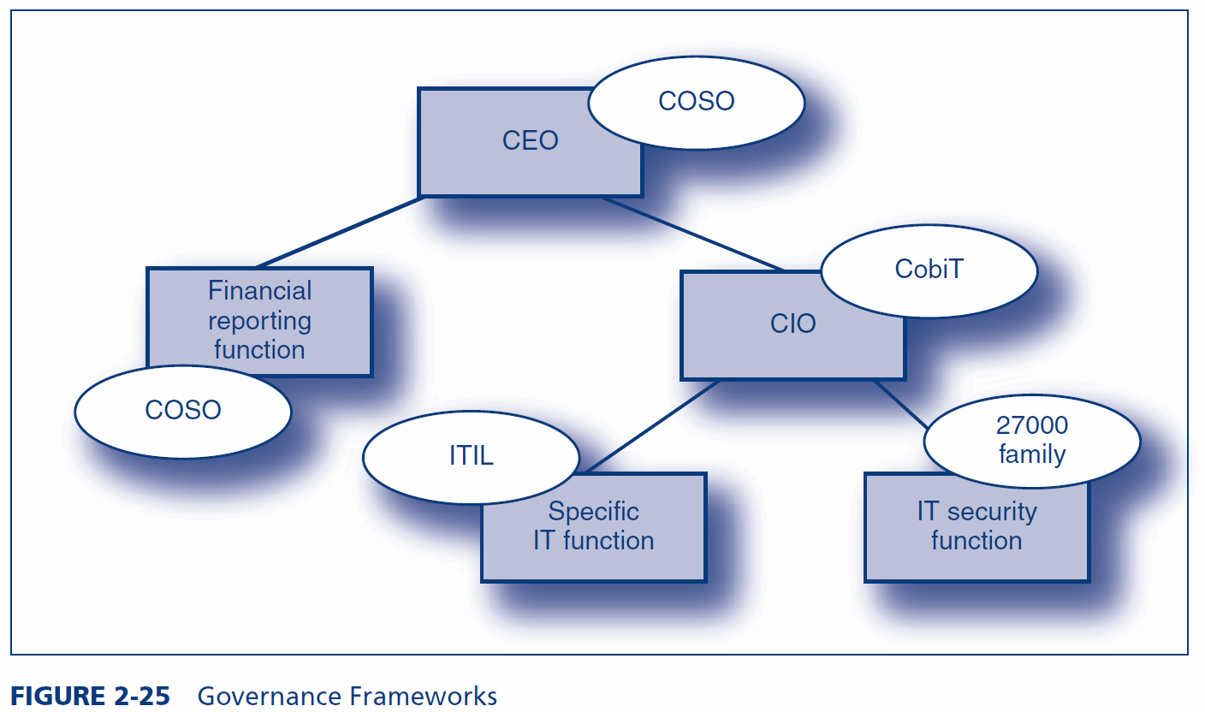
FINAL THOUGHTS: Governance Frameworks

Slide 33
COSO
Origins : Committee of Sponsoring Organizations of the Treadway Commission (www.coso.org)
Ad hoc group to provide guidance on financial controls
Focus
Corporate operations, financial controls, and compliance
May be required for compliance
Goal is reasonable assurance that goals will be met
Components
Risk assessment : Ongoing
Control activities: General policy plus specific procedures
Monitoring
Both human vigilance and technology
Information and communication
Must ensure that the company has the right information for controls
Must ensure communication across all levels in the corporation
CobiT
Control Objectives for Information and Related Technologies
CIO-level guidance on IT governance
Offers many documents that help organizations understand how to implement the framework
The CobiT Framework
Four major domains
34 high-level control objectives
Planning and organization (10)
Acquisition and implementation (7)
Delivery and support (13)
Monitoring (4)
More than 300 detailed control objectives

Slide 34
The ISO/IEC 27000 Family of Security Standards
ISO/IEC 27000
Family of IT security standards with several individual standards
From the International Organization for Standardization (ISO) and the International Electrotechnical Commission (IEC)
ISO/IEC 27002
Originally called ISO/IEC 17799
Recommendations in 11 broad areas of security management
ISO/IEC 27001
Created in 2005, long after ISO/IEC 27002
Specifies certification by a third party
COSO and CobiT permit only self-certification
Business partners prefer third-party certification
Other 27000 Standards
Many more 27000 standards documents are under preparation

Slide 35
ISO/IEC 27002: Eleven Broad Areas
Security policy | Access control
Organization of information security | Information systems acquisition, development and maintenance
Asset management | Information security incident management
Human resources security | Business continuity management
Physical and environmental security | Compliance
Communications and operations management

